Slide 1
Effectiveness of Project Model Learning Tools Assisted by Augmented Reality to Improve Students' Scientific Literacy and Creative Thinking Abilities
ICSSTE (The 1st International Conference on Sustainable Science, Technology, and Education)
By:
Dr. Ahmad Harjono, M.Pd.
Prof. Dr. Gito Hadiprayitno, M.Si.
Naf’atuzzahrah, M.Pd.
Master of Science Education
University of Mataram

Slide 2
PART
01
03
02
04
INTRODUCTION
RESULT AND DISCUSSION
METHODE
CONCLUSION

Slide 3
01
INTRODUCTION

Slide 4
BACKGROUND
Teachers have efforts to carry out creative innovations in learning that lead to achieving learning objectives (science learning)
Teachers integrate the use of technology in the learning process (science learning)
Students have adequate scientific literacy and creative thinking abilities
Fact/Problem
Products that have been developed need to be tested to determine their level of effectiveness in their application to learning activities (Multazam et al., 2023)
Students' science learning outcomes are still relatively low (a learning process that has not directed students to train their thinking skills and solve problems scientifically)
Facilities and infrastructure, learning sources and media in science learning are still very limited
Science learning has not been integrated with the use of technology
Teachers have limitations in preparing learning tools
“Development of Project Model Learning Tools Assisted by Augmented Reality to Improve Students' Scientific Literacy and Creative Thinking Abilities”
Hope
Solution

Slide 5
Research Purposes
The aim of this research is to determine the effectiveness of project model learning tools assisted by augmented reality to improve students' scientific literacy and creative thinking abilities.

Slide 6
02
METHODE

Slide 7
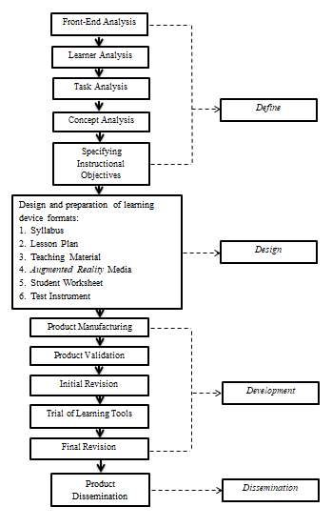
Types and Stages of Research
This research is a type of research and development with the design used, namely a 4D model. Research with 4D model design consists of four main stages, namely define, design, development and dissemination
Figure 1. 4D Research Procedures

Slide 8
Data Collection Instrument
Testing the effectiveness of learning device products is carried out at the third stage, namely the development stage. Effectiveness testing can be carried out after validation testing and practicality testing of learning tool products. This effectiveness test was carried out on a limited scale and a wide scale on class VIII MTs students. A limited scale trial was carried out in one class with 20 students. Meanwhile, wide-scale trials were carried out in three different classes with a total of 59 students.
The effectiveness test instrument is in the form of pre-test and post-test questions to measure the increase in scientific literacy and creative thinking abilities of students which consists of 8 descriptive questions.

Slide 9
Data Analysis Techniques
N-gain Test
Table 1. N-gain Value Category
N-gain Score | Category
$$g >0,7$$ | High
$$0,3 ≤g ≤0,7$$ | Medium
$$g <0,3$$ | Low
$$N−gain= \frac{S_{post}−S_{pre}}{S_{max}−S_{pre}}$$
(Harjono et al., 2020).
Information:
$S_{post}$ = Post-test score
$S_{pre}$ = Pre-test score
$S_{max}$ = Maximum score
Table 2. Interpretation of N-gain Effectiveness
N-gainScore (%) | Category
$$>80$$ | Very Effective
$$60<p≤80$$ | Effective
$$40<p≤60$$ | Quite Effective
$$20<p≤40$$ | Less Effective
$$p≤20$$ | Ineffective
(Widoyoko, 2017).

Slide 10
03
RESULT AND DISCUSSION

Slide 11
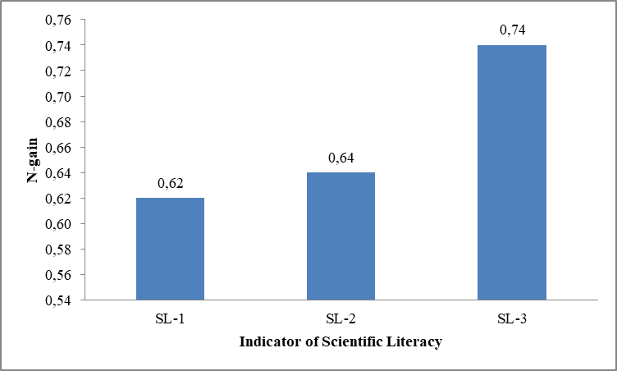
1. Limited Scale Trial Result
Scientific Literacy
The results in Table 3 show an increase in students' scientific literacy which is included in the medium category with an N-gain value of 0.67 or 67%, which is included in the effective criteria.
Figure 2 shows that the scientific literacy indicators, namely explaining phenomena scientifically (SL-1) with an N-gain value of 0.62 and designing and evaluating scientific investigations (SL-2) with an N-gain value of 0.64, are included in the medium improvement category. Meanwhile, the scientific literacy indicator interpreting data and evidence scientifically (SL-3) with an N-gain value of 0.74 is included in the high category of improvement.
Figure 2. N-gain Results of Scientific Literacy Per Indicator

Slide 12
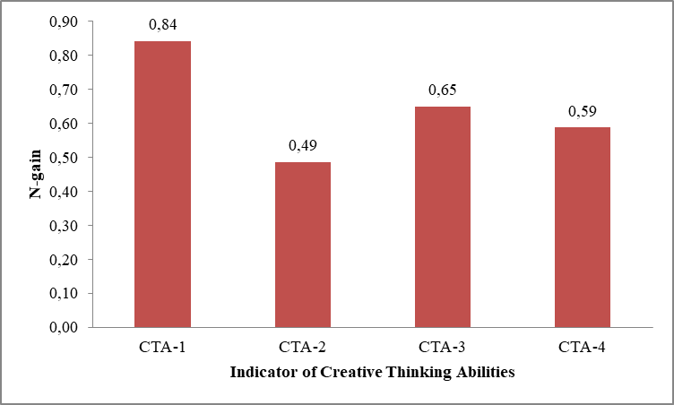
1. Limited Scale Trial Result
Creative Thinking Abilities
The results in Table 4 show an increase in students' creative thinking abilities which are included in the medium category with an N-gain value of 0.64 or 64%, which is included in the effective criteria.
Figure 3 shows that the indicator of creative thinking abilities, namely fluency (CTA-1), is included in the high category with a value of 0.84. Meanwhile, the indicators of creative thinking abilities, flexibility (CTA-2) with a value of 0.49, authenticity (CTA-3) with a value of 0.65 and detail (CTA-4) with a value of 0.59 are included in the medium category of improvement.
Figure 3. N-gain Results of Creative Thinking Abilities Per Indicator

Slide 13
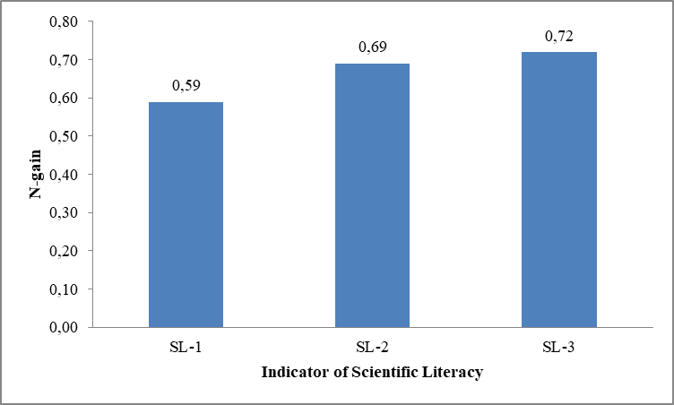
2. Wide Scale Trial Result
Scientific Literacy
The results in Table 5 show an increase in students' scientific literacy which is included in the medium category with an average N-gain value of 0.66 or 66%, which is included in the effective criteria.
Figure 4 shows that the scientific literacy indicators, namely explaining phenomena scientifically (SL-1) with a value of 0.59 and designing and evaluating scientific investigations (SL-2) with a value of 0.69, are included in the medium improvement category. Meanwhile, the scientific literacy indicator interpreting data and evidence scientifically (SL-3) with a value of 0.72 is included in the high category of improvement.
Figure 4. N-gain Average Scientific Literacy

Slide 14
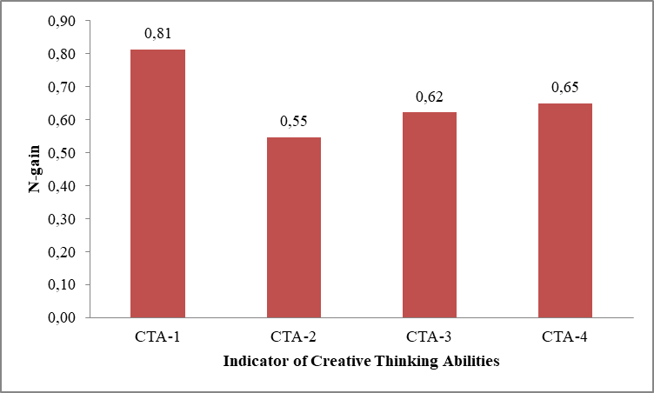
2. Wide Scale Trial Result
Creative Thinking Abilities
The results in Table 6 show an increase in students' creative thinking abilities which are included in the medium category with an average N-gain value of 0.65 or 65%, which is included in the effective criteria.
Figure 5 shows that the indicator of creative thinking abilities, namely fluency (CTA-1), is included in the high category with a value of 0.81. Meanwhile, the indicators of creative thinking abilities, flexibility (CTA-2) with a value of 0.55, authenticity (CTA-3) with a value of 0.62 and detail (CTA-4) with a value of 0.65 are included in the medium category of improvement.
Figure 5. N-gain Results of Creative Thinking Abilities Per Indicator

Slide 15
04
CONCLUSION

Slide 16
Conslusion
The learning tools developed with a project model assisted by augmented reality has effective criteria in the medium category to improving students' literacy and creative thinking abilities based on the results of limited trials and wide-scale trials, so that the product developed can be used in science learning at school.

Slide 17
Thanks!

