Slide 1
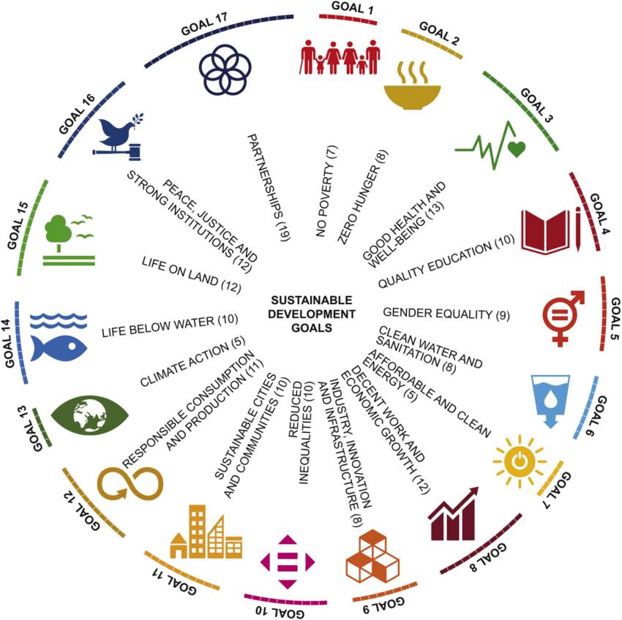
Empowering Future Generations: A Systematic Review of Project-based Learning's Role in Achieving Sustainable Development Goals
FITRIANI

Slide 2
Background & Global Context
1
21st Century Challenges: Acceleration of environmental, climate, and social inequality crises.
2
Global Response: Establishment of the 17 Sustainable Development Goals (SDGs) as the blueprint for global action until 2030.
3
Key Pillar: Education for Sustainable Development (ESD), mandated by SDG 4 (Quality Education), acts as the primary catalyst for fostering proactive change agents.

Slide 3
Background & Global Context
1
Core Problem: The existence of a significant Action-Awareness Gap. Students possess high theoretical knowledge of SDGs but often fail to translate it into practical action or implement real-world solutions.
2
Traditional Weakness: Conventional lecture methods fail to cultivate the complex 21st-century skills (e.g., critical thinking, collaboration) required by the SDGs.
3
Solution Need: A shift toward an active, authentic, and interdisciplinary pedagogical paradigm is essential.
5
Focus Solution: Project-based Learning (PjBL) as the ideal approach for authentic problem-solving and application.

Slide 4
Objectives and Contribution of the Systematic Review
1
Main Goal: To systematically analyze and synthesize the role of PjBL in supporting the achievement of SDGs across diverse educational levels and contexts.
2
Key Research Questions (RQ):
Effectiveness: How effective is PjBL in boosting HOTS & 21st Century Skills (Critical Thinking, Creativity)?
Mechanism: How does PjBL bridge the Action Gap and foster student Agency/Motivation?
Sustainability: What are the Critical Obstacles, Contexts, and Implications for achieving sustained implementation?

Slide 5
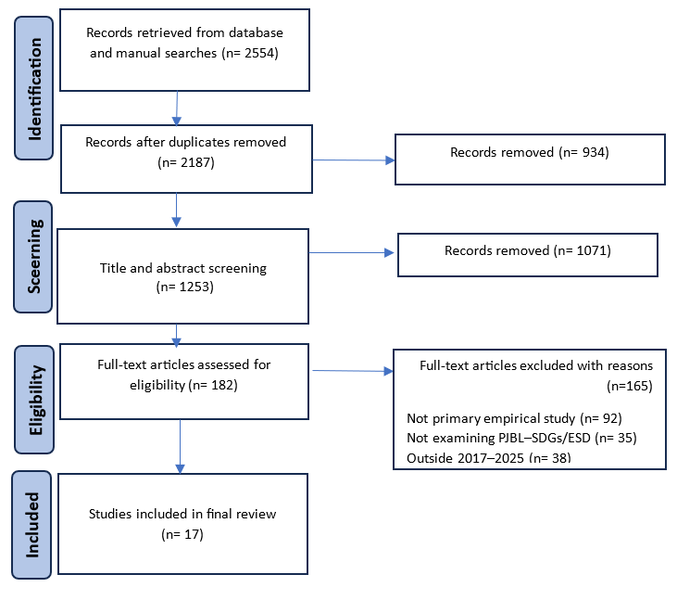
Methodology
Main Goal: To systematically analyze and synthesize the role of PjBL in supporting the achievement of SDGs across diverse educational levels and contexts.

Slide 6
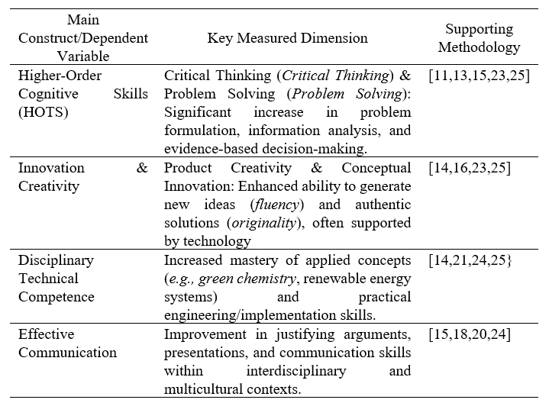
Result&Discussion
To what extent is PjBL effective in improving the specific competencies students need to achieve the SDGs, especially 21st-century skills
This review highlights the strong empirical evidence that Project-based Learning (PjBL) effectively enhances Higher Order Thinking Skills (HOTS) and 21st Century Skills relevant to the Sustainable Development Goals (SDGs). PjBL promotes significant gains in critical thinking, innovation, and creativity through authentic problem-solving and real-world applications. Moreover, it strengthens students’ disciplinary competence and communication skills, enabling them to justify and present sustainable solutions effectively.

Slide 7
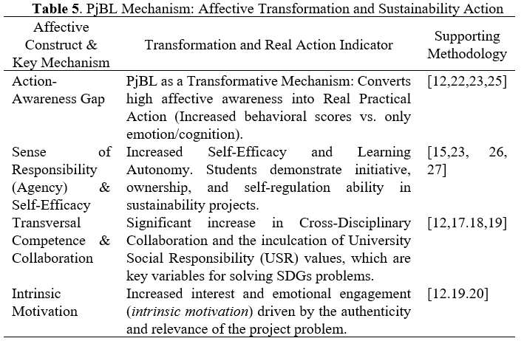
Result&Discussion
  How does PjBL function as a mechanism to bridge the gap between theoretical awareness and SDG action implementation, and how does it affect students' motivation, self-efficacy, and sense of social responsibility?
The analysis shows that Project-based Learning (PjBL) functions as a transformative mechanism bridging the gap between students’ awareness of sustainability and their real actions. By engaging students in authentic projects, PjBL transforms passive knowledge into meaningful practice, fostering agency, self-efficacy, and intrinsic motivation. Moreover, its collaborative nature strengthens transversal competencies such as teamwork and interdisciplinary collaboration, making it a powerful approach for Education for Sustainable Development (ESD).

Slide 8
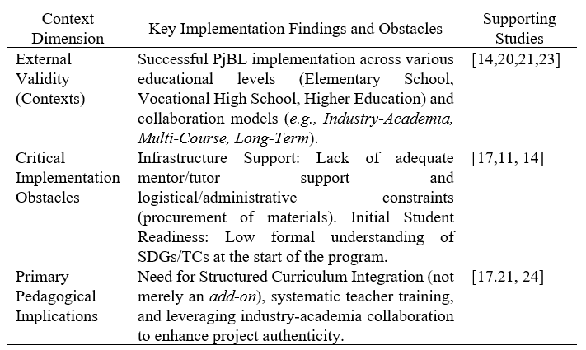
Result&Discussion
  In what educational contexts has PjBL proven effective in integrating SDGs, and what are the most consistent implementation challenges and recommendations emerging from primary studies?
This review confirms the broad effectiveness and adaptability of Project-Based Learning (PjBL) in supporting Education for Sustainable Development (ESD) across diverse educational levels and disciplines. However, its sustainability is hindered by institutional, infrastructural, and student-readiness challenges that affect implementation quality and motivation. Therefore, structured curriculum integration, stronger industry–academic collaboration, and comprehensive teacher support are essential to ensure long-term PjBL success in achieving SDG-oriented education.

Slide 9
Conclution
This systematic literature review clearly confirms that Project-based Learning (PjBL) is a fundamental pedagogical strategy for empowering future generations to achieve the Sustainable Development Goals (SDGs). PjBL has been proven to consistently improve Higher Order Thinking Skills (HOTS) and 21st Century Skills, functioning as a Transformative Mechanism that bridges the gap between theoretical knowledge and Practical Action and fosters a high sense of Agency among students. Although the effectiveness and external validity of PjBL extend across various levels of education, its sustainable implementation requires institutional-level reforms—including Structured Curriculum Integration and investment in efficient Administrative Support Mechanisms to overcome Critical Barriers and position PjBL as a strategic key to global development.

Slide 10
Instructions for use
TERIMA KASIH

